Slide 1

LCD Controller
By
Sayeed Anwar Syed Kamal (31510156)

Slide 2
Introduction
Liquid Crystal Display(LCDs) provide a cost-effective way to output text for a microcontroller or FPGA.
Most Embedded and FPGA projects requires the use of outputting some sort of text-based graphics.
The 16x2 dot-matrix liquid crystal display controller can display alpha numerals, Japanese kana characters, and symbols.
It can be configured to drive the 16x2 dot-matrix liquid crystal display under the control of a 4- or 8-bit microprocessor.
Since all the functions such as display RAM, character generator, and liquid crystal driver, required for driving a dot-matrix liquid crystal display are internally provided on one chip, a minimal system can be interfaced with this controller/driver.
The Display Controller takes commands and data from an external microcontroller and drivers the LCD panel. It takes an ASCII value as input and generate a patter for the dot matrix. E.g., to display letter 'A'
The low power supply (2.7V to 5.5V) of the 16x2 dot-matrix liquid crystal display is suitable for any portable battery-driven product
16x2 LCD is used extensively in electronic devices like calculators, computers, microwaves, etc.

Slide 3
Project Description
The objective of this project is to build an LCD controller.
A firmware is written in VHDL language to initialize the 16x2 LCD and get it ready to receive data for displaying desired characters on the screen.
The characters displayed on the LCD can be changed by changing the bits from a set of switches in the FPGA board to display a mapped character on the LCD screen.
The mapping of characters is given by the ASCII table provided in the 16x2 LCD data sheet.
Time delays and control signals are generated for the LCD along with displaying specific data by sending different binary combinations through the LCD data bus.
The LCD pins from the FPGA board is used to interact with the LCD module.
By altering the pin states, we can display characters of choice.

Slide 4
LCD Controller State Space
Start
Pwr
Init
Done

Slide 5
Program Logic
Clear Display
Function Set
Display ON
Increment Mode
Cursor Return Home
Send LCD Data

Slide 6
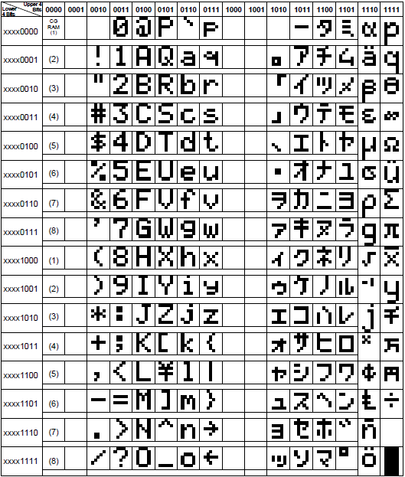
ASCII Table for Character Mapping

Slide 7
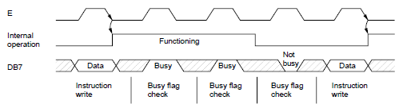
Writing Instructions to 16x2 LCD
Note: In order to write an instruction, the enable must change from a high state to a low state. This allows the LCD Controller to latch onto the user instruction.

Slide 8
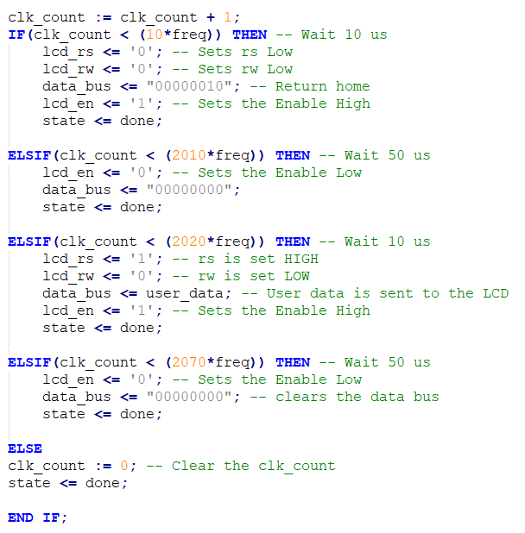
Generating Delays for Control Signals
Clk_count counts the rising edge of the clock.
Clk_count = 50, translates to 1 microsecond delay.
The system clock is 50 MHZ we divide 50 Mhz by 50 which gives us 1 Mhz
To find the delay we take the inverse of 1 mhz which gives us a delay of 1 microsecond.
Similarly, n*freq provides a time delay of N*(1 us). Where N is a positive integer.

Slide 9
References
https://mil.ufl.edu/3744/docs/lcdmanual/commands.html
https://openlab.citytech.cuny.edu/wang-cet4805/files/2017/04/LCD-controller-and-User-Logic-in-VHDL-and-Programming-a-FPGAs_posted.pdf
http://www.digital-circuitry.com/Projects_LCD_DISPLAYS.htm

